Slide 1

Final Presentation
On
Kaggle Contest
Deep Learning
AI5100
(2024)
Presented By :
Shreesh Gupta (CS23MTECH12009)
Shrenik Ganguli (CS23MTECH14014)
Team Name:
Kaggle Master

Slide 2

CONTENTS
Challenge
Failed Strategies
ResNet-18
ResNet-50
ViT-L-16
Analysis
Successful Strategy: ResNet-152
Conclusion

Slide 3
CHALLENGE
We were given a dataset which is a subset of the ImageNet Large Scale Visual Recognition Challenge 2012 dataset (ILSVRC2012)
Our dataset consists of the train and test sets. The train dataset has 50 classes (instead of 1000) and each class originally had 1300 samples. The test dataset has 38,366 images.
Our challenge is to accurately predict the classes of the images in the test dataset and achieve highest accuracy on private + public leaderboard on this standard multi class classification task.

Slide 4
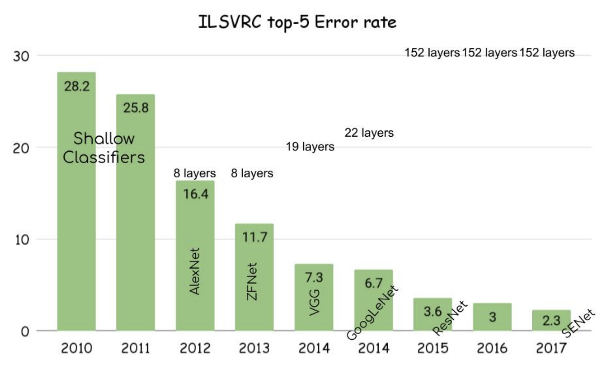
FAILED STRATEGIES
Strategy-1​​: ResNet-18
Why we used it?
Among CNNs, ResNet is more computationally efficient than AlexNet or VGG
ResNet gives the least error rate on ILSVRC dataset as can be seen from the image below
ResNet-18, with its deeper architecture, can capture intricate patterns and details in the images

Slide 5
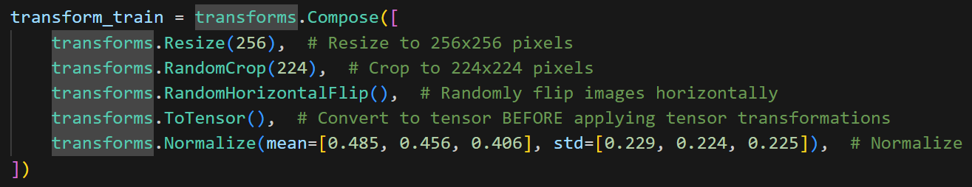
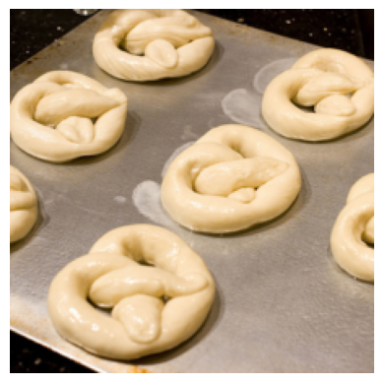
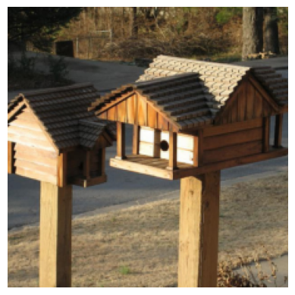
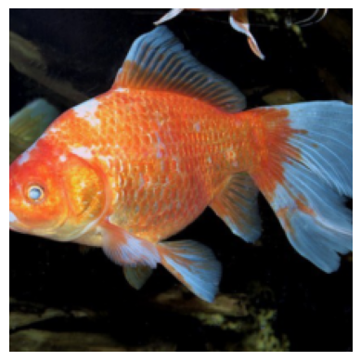
FAILED STRATEGIES (contd.)
Strategy-1​​: ResNet-18 (contd.)
Image Preprocessing:
Below are the images after preprocessing:

Slide 6
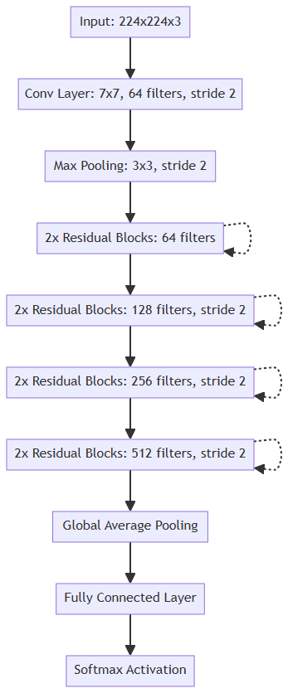
FAILED STRATEGIES (contd.)
Strategy-1​​: ResNet-18 (contd.)
Model Architecture:
Input image size: 224 ⛌ 224 ⛌ 3
7 ⛌ 7 Convolutional layer with 64 filters, stride 2, followed by BatchNorm and ReLU.
3 ⛌ 3 Max Pooling layer with stride 2.
Residual Blocks:
2 blocks of 64 filters each.
2 blocks of 128 filters each, stride 2.
2 blocks of 256 filters each, stride 2.
2 blocks of 512 filters each, stride 2.
Global Average Pooling.
Fully Connected Layer which outputs class probabilities.
Softmax Activation.

Slide 7
FAILED STRATEGIES (contd.)
Strategy-1​​: ResNet-18 (contd.)
Hyperparameters and Regularizers:
Optimiser used : Stochastic Gradient Descent (SGD)
Learning Rate : 1e-2
Momentum : 0.9
Weight Decay : 1e-4
No. of epochs : 100
Scheduler : StepLR
Step size : 30
Gamma : 0.1
Batch Size : 256
Regularizers :
Batch Normalization
L2 Regularization (Weight Decay)
Results obtained with this: Private Score: 0.51039, Public score: 0.67200
Lower score possibly due to lesser model complexity than ResNet-50

Slide 8
FAILED STRATEGIES (contd.)
Strategy-2​​: ResNet-50
Why we used it?
ResNet gives the least error rate on ILSVRC dataset as can be seen from the image below
ResNet-50 balances complexity and computational cost well.
Deeper architecture captures hierarchical features effectively.
More generalized thus transfers well to various tasks and datasets.

Slide 9
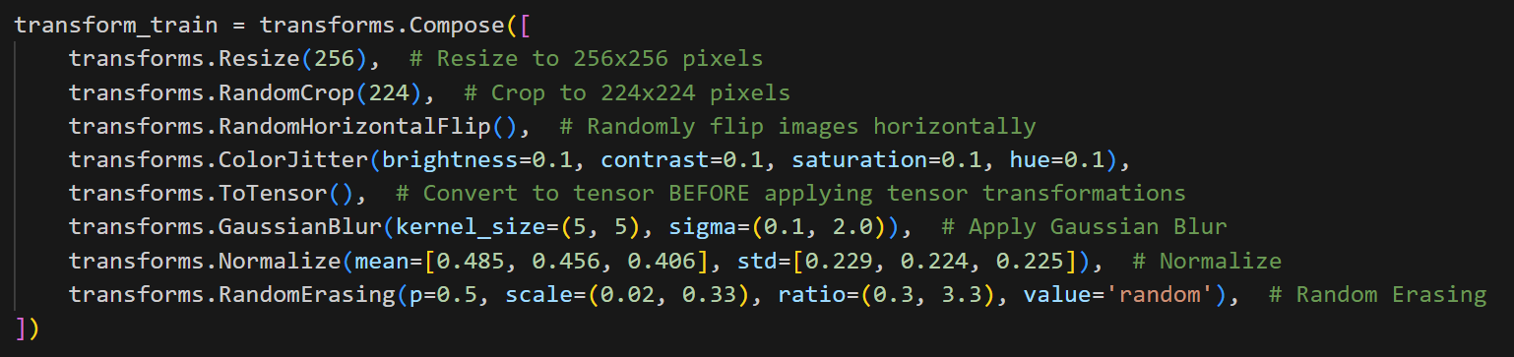
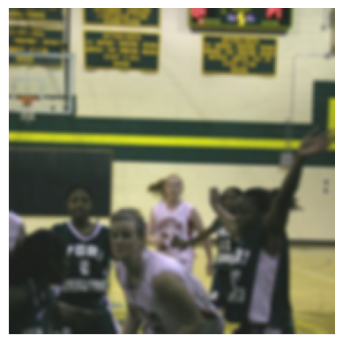
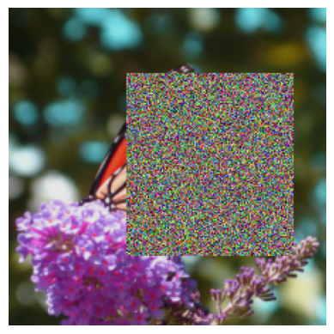
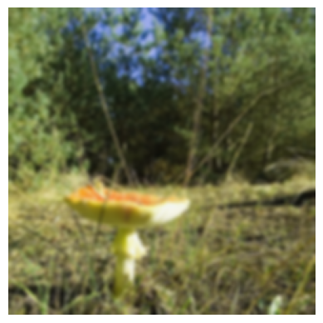
FAILED STRATEGIES (contd.)
Strategy-2​​: ResNet-50 (contd.)
Image Preprocessing:
Below are the images after preprocessing:

Slide 10

FAILED STRATEGIES (contd.)
Strategy-2​​: ResNet-50 (contd.)
Model Architecture:
Input image size: 224 ⛌ 224 ⛌ 3
7 ⛌ 7 Convolutional layer with 64 filters, stride 2, followed by BatchNorm and ReLU.
3 ⛌ 3 Max Pooling layer with stride 2.
Residual Blocks:
3 blocks of 64 filters each.
4 blocks of 128 filters each, first block with stride 2, others with stride 1.
6 blocks of 256 filters each, first block with stride 2, others with stride 1.
3 blocks of 512 filters each, first block with stride 2, others with stride 1.
Global Average Pooling.
Fully Connected Layer which outputs class probabilities.
Softmax Activation.

Slide 11
FAILED STRATEGIES (contd.)
Strategy-2​​: ResNet-50 (contd.)
Hyperparameters and Regularizers : Same as that of ResNet-18 except batch_size = 64.
Results obtained with this:
Training done in two stages - first without preprocessing, then with preprocessing
Private Score: 0.39126, Public score: 0.55573
Training on entire dataset with preprocessing
Private Score: 0.54492, Public score: 0.62133
Lower score possibly due to
Lesser model complexity than ResNet152
Preprocessing and regularization was heavy which distorted the dataset

Slide 12
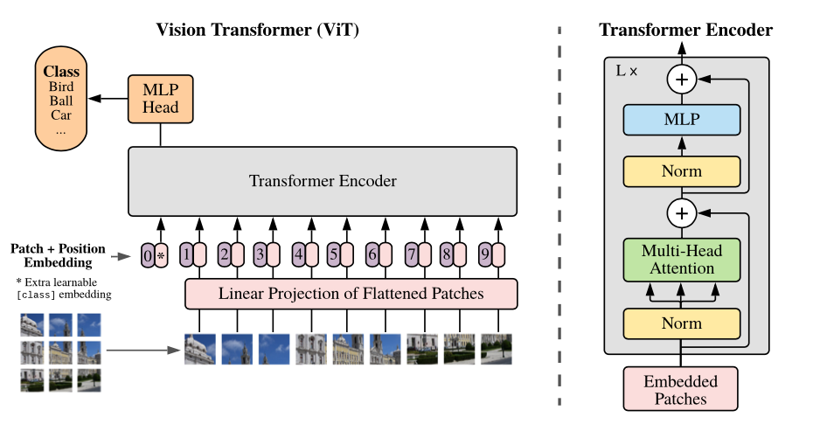
FAILED STRATEGIES (contd.)
Strategy-3​​: ViT-L-16
Why we used it?
Transformer-based model
ViTs employ self-attention mechanisms, which allow them to selectively focus on relevant parts of the input image.
Transformers, used in ViTs, can capture long-range dependencies in images.
Unlike traditional CNNs, which require fixed-size inputs, ViTs can handle inputs of variable sizes.
ViTs utilize positional encoding to inject spatial information into the input sequence.

Slide 13
FAILED STRATEGIES (contd.)
Strategy-3​​: ViT-L-16 (contd.)
Image Preprocessing: Same as that of ResNet-18
Below are the images after preprocessing:

Slide 14
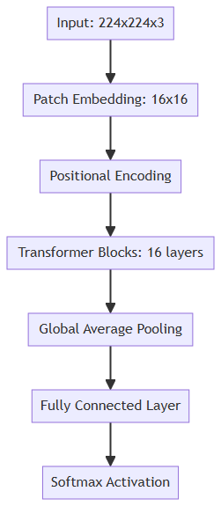
FAILED STRATEGIES (contd.)
Strategy-3​​: ViT-L-16 (contd.)
Model Architecture:
Input image size: 224 ⛌ 224 ⛌ 3
Patch Embedding Layer: Divides the input image into fixed-size patches and linearly embeds each patch to a lower-dimensional vector.
Positional Encoding: Adds positional encodings to the patch embeddings to provide spatial information.
16 Transformer encoder layers, each consisting of:
Multi-head self-attention mechanism to capture dependencies.
Feedforward neural network (MLP) with a skip connection and layer normalization.
Classification Head:
Global Average Pooling: Aggregates the features across spatial dimensions.
Fully Connected Layer: Outputs class probabilities.
Softmax Activation: Converts logits into class probabilities.

Slide 15
FAILED STRATEGIES (contd.)
Strategy-3​​: ViT-L-16 (contd.)
Hyperparameters and Regularizers : Same as that of ResNet-18 except batch_size = 256.
Results obtained with this: Private Score: 0.50031, Public score: 0.6656
Lower score possibly due to
Requires more computation power and memory than ResNet (would beat ResNet if run for at least 200 epochs)

Slide 16
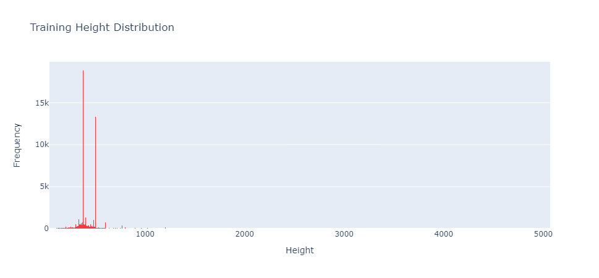
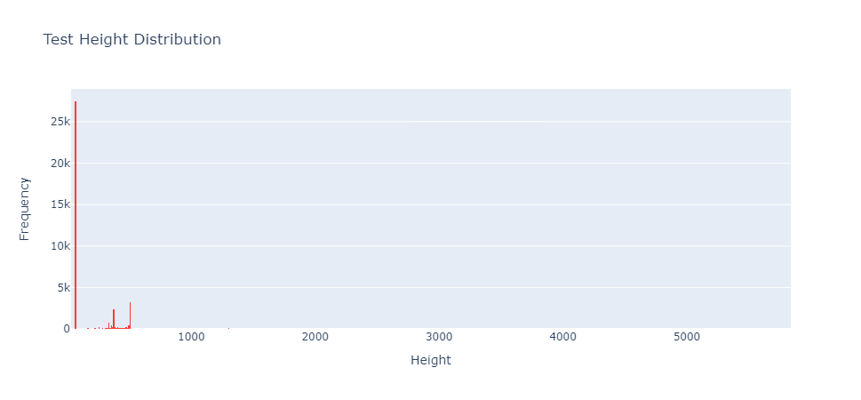
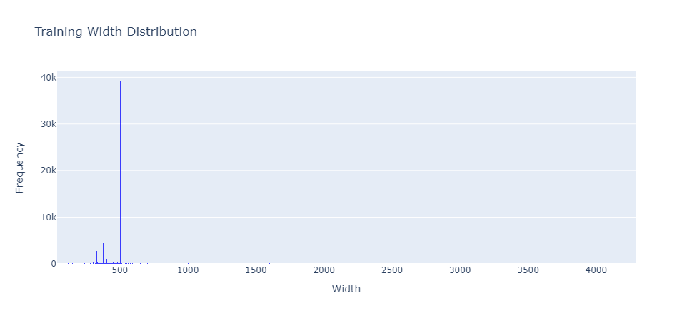
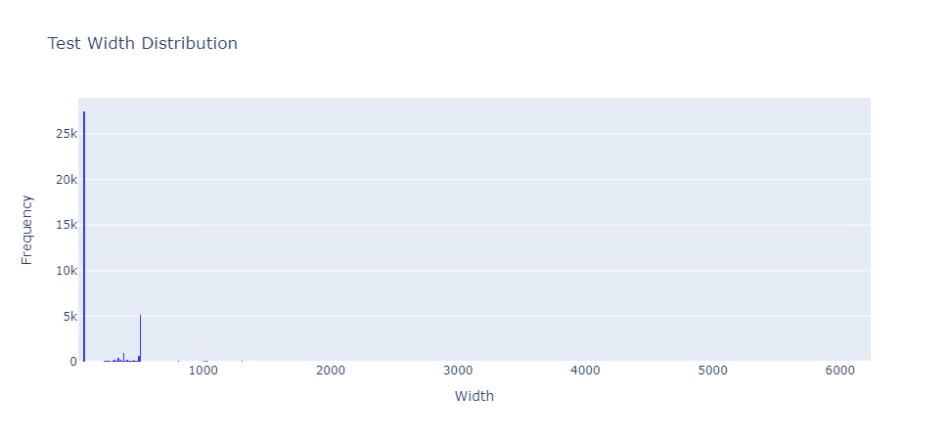
ANALYSIS

Slide 17
ANALYSIS (contd.)
After plotting the graphs of Height and Width Distributions for the training and testing datasets we can observe that:
Most of the images in the training dataset have width between 500-504 (39.215k) and height between 375-379 (18.89k)
However, in the testing dataset most of the images have height and width between 60-69 (27.503k)
We see that the size of the images in training dataset are disproportionately larger than those in the test dataset. Hence, in the preprocessing stage, instead of resizing images to 224⛌224, we now resize them to 64⛌64.

Slide 18
SUCCESSFUL STRATEGY
ResNet-152 (with preprocessing)
Why we used it?
ResNet gives the least error rate on ILSVRC dataset as can be seen from the image below
ResNet-152 typically outperforms shallower variants like ResNet-18 or ResNet-50 because of increased depth which enables it to learn more complex representations
Despite its depth, ResNet-152 is designed with techniques like batch normalization and skip connections that help mitigate overfitting

Slide 19
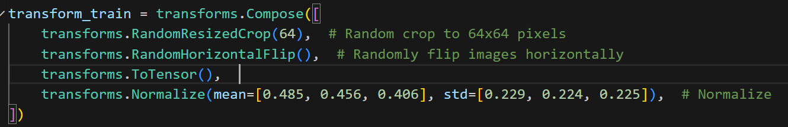
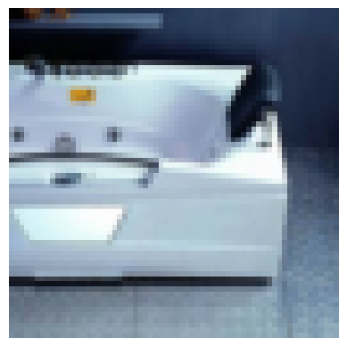
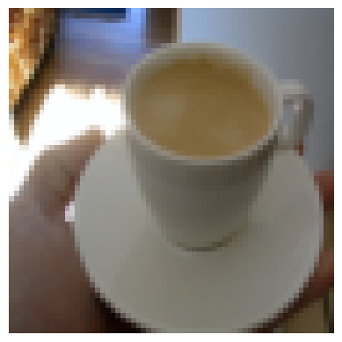
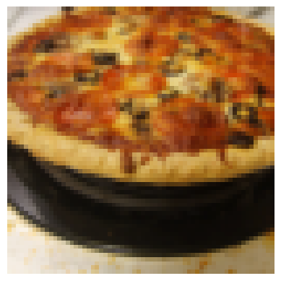
SUCCESSFUL STRATEGIES (contd.)
ResNet-152 (contd.)
Image Preprocessing:
Below are the images after preprocessing:

Slide 20
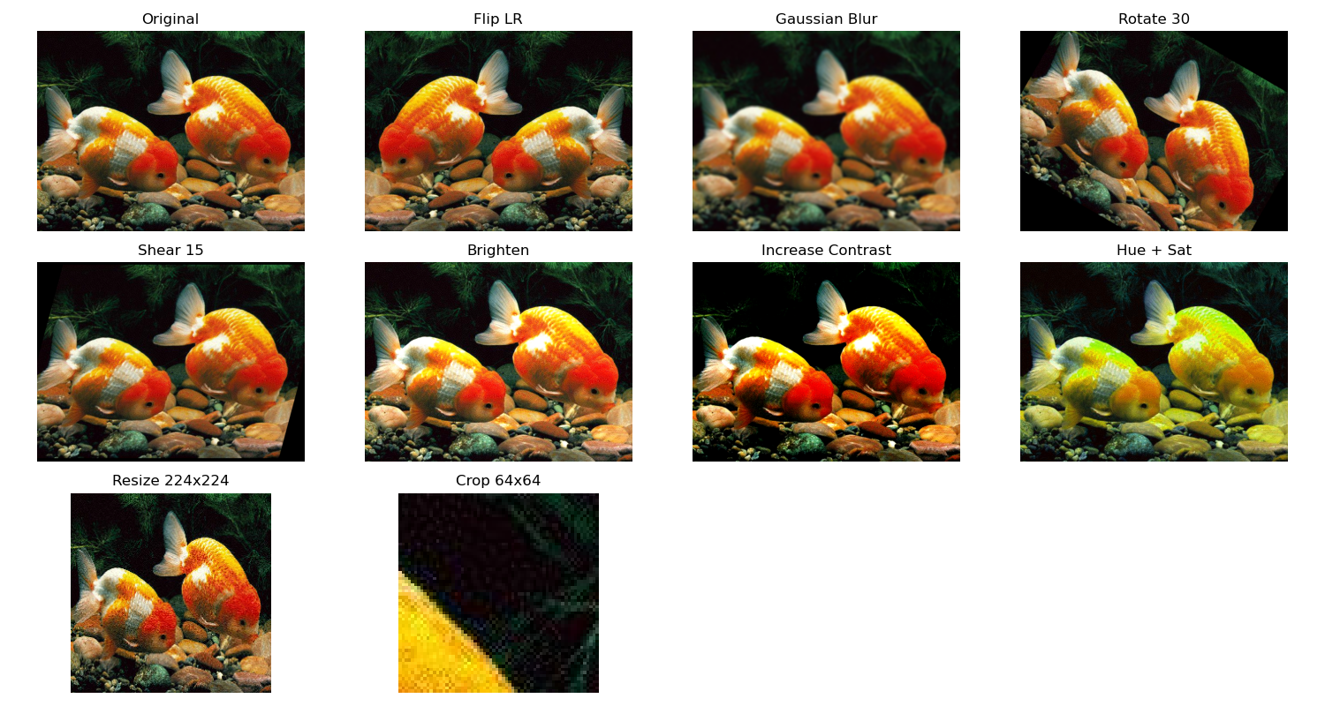
SUCCESSFUL STRATEGIES (contd.)
ResNet-152 (contd.)
Data Augmentation
We performed Data Augmentation by creating 5 new images for each original image in the dataset. This was done by performing the seven operations shown above. Thus our new dataset now contains 7800 images per class. Creating more data helps in feature extraction and model generalisation, since in general, more data results in better accuracy!

Slide 21
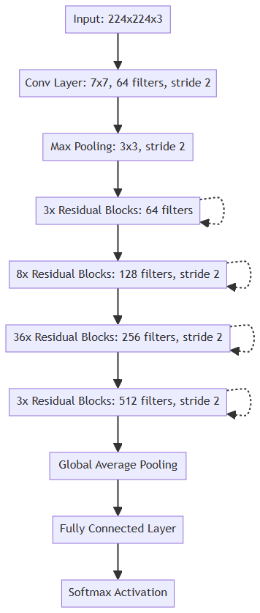
SUCCESSFUL STRATEGIES (contd.)
ResNet-152 (contd.)
Model Architecture:
Input image of size 224 ⛌ 224 ⛌ 3
7 ⛌ 7 Convolutional layer with 64 filters, stride 2, followed by BatchNorm and ReLU.
3 ⛌ 3 Max Pooling layer with stride 2.
Residual Blocks:
3 blocks of 64 filters each.
8 blocks of 128 filters each, first block with stride 2, others with stride 1.
36 blocks of 256 filters each, first block with stride 2, others with stride 1.
3 blocks of 512 filters each, first block with stride 2, others with stride 1.
Global Average Pooling.
Fully Connected Layer which outputs class probabilities.
Softmax Activation.

Slide 22
SUCCESSFUL STRATEGIES (contd.)
ResNet-152 (contd.)
Results obtained with data augmentation
Hyperparameters and Regularizers:
Optimiser used : Stochastic Gradient Descent (SGD)
Learning Rate : 1e-2
Momentum : 0.9
Weight Decay : 1e-4
No. of epochs : 100
Scheduler : StepLR
Step size : 30
Gamma : 0.1
Batch Size : 256
Regularizers :
Batch Normalization
L2 Regularization (Weight Decay)
Results obtained with this: Private Score: 0.87098, Public score: 0.90533 (best scores achieved by us)

Slide 23


SUCCESSFUL STRATEGIES (contd.)
Final Standings on Kaggle Leaderboard
Final standings achieved by this: Rank-2 on Private Leaderboard, Rank-1 on Public Leaderboard
Public LeaderBoard (Score - 0.90533)
Private LeaderBoard (Score - 0.87098)

Slide 24
CONCLUSION
Thus, we see that our final model ResNet-152 with data augmentation and image preprocessing, accurately predicts the class of 87% of the test images.
However, we think that the accuracy can be further improved by:
Training with ViT for greater number of epochs (requires better computational resources like GPU)
Training ensemble models for better generalization over large dataset

Slide 25
THANK YOU!

